Slide 1


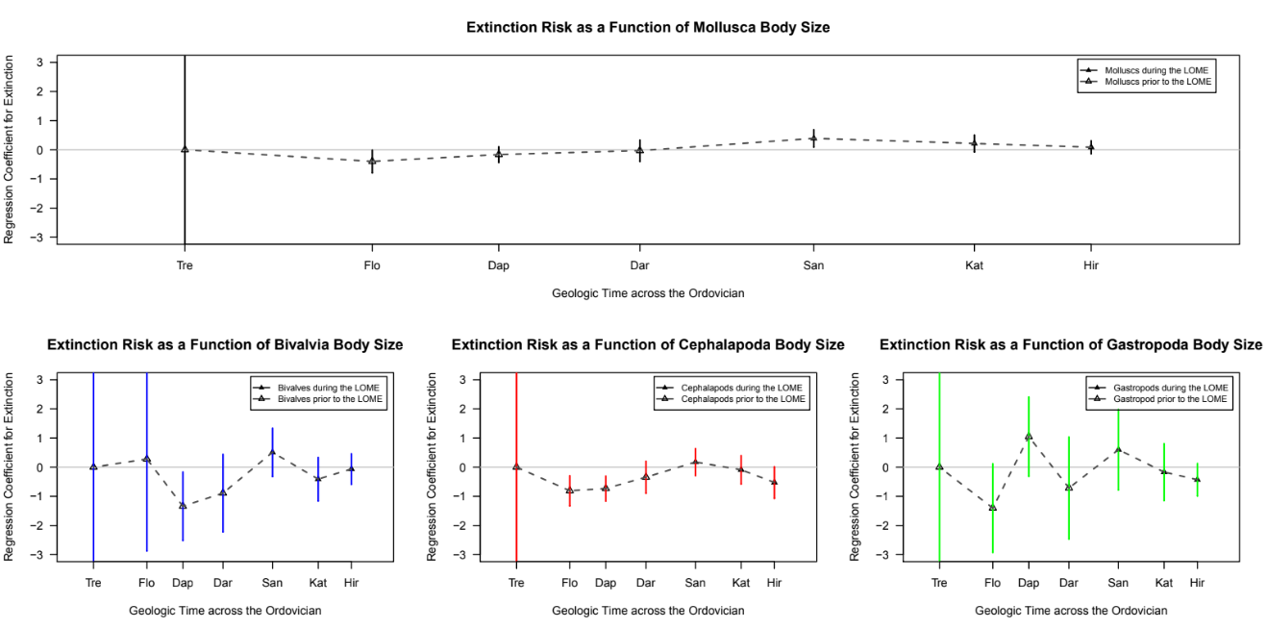
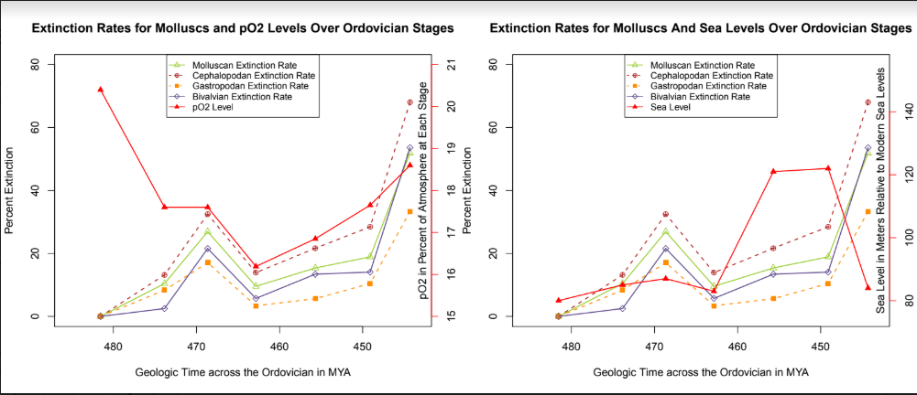
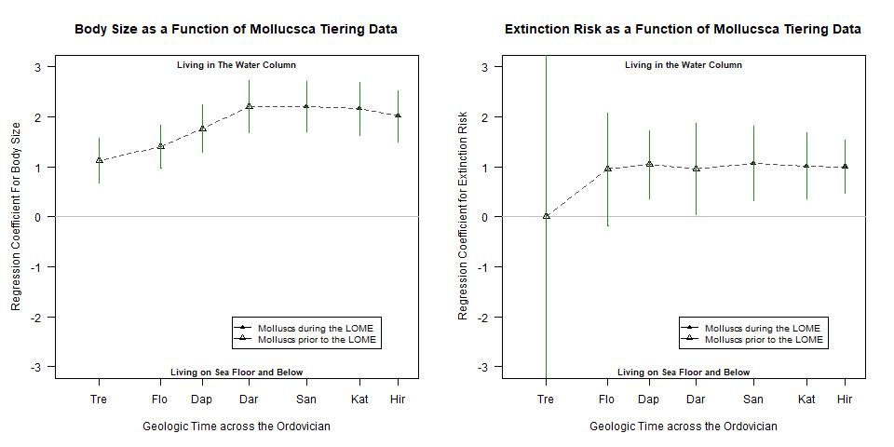
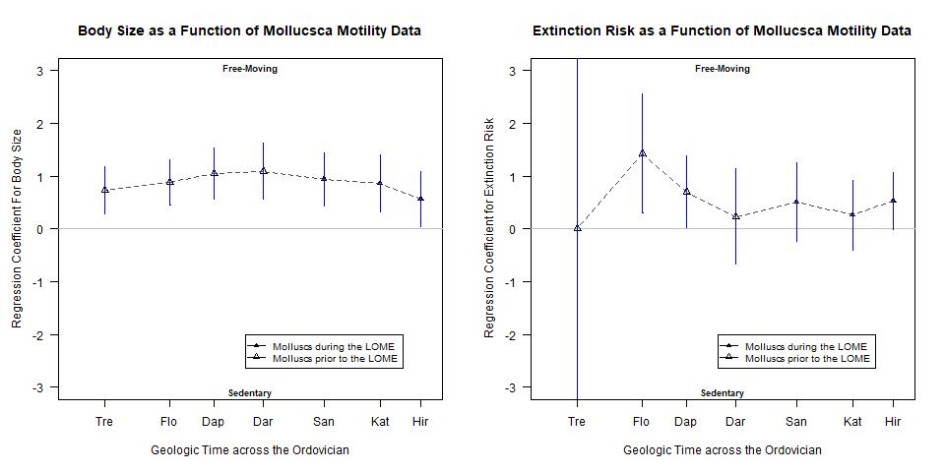
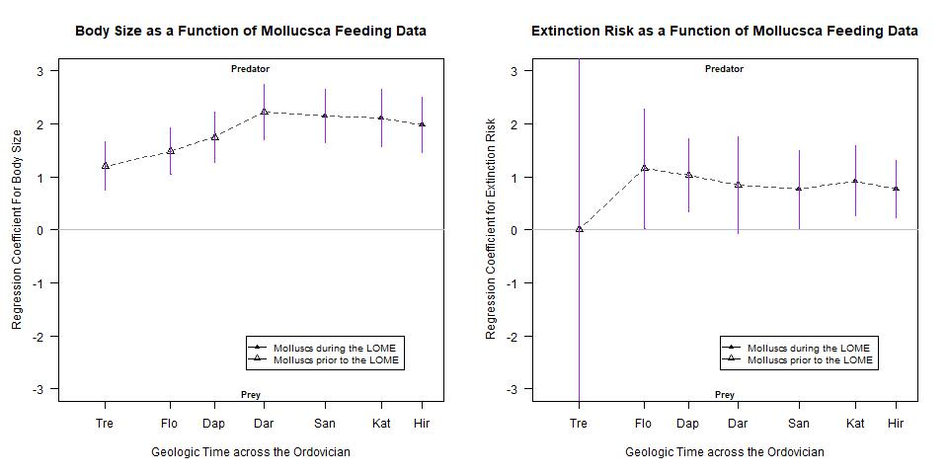
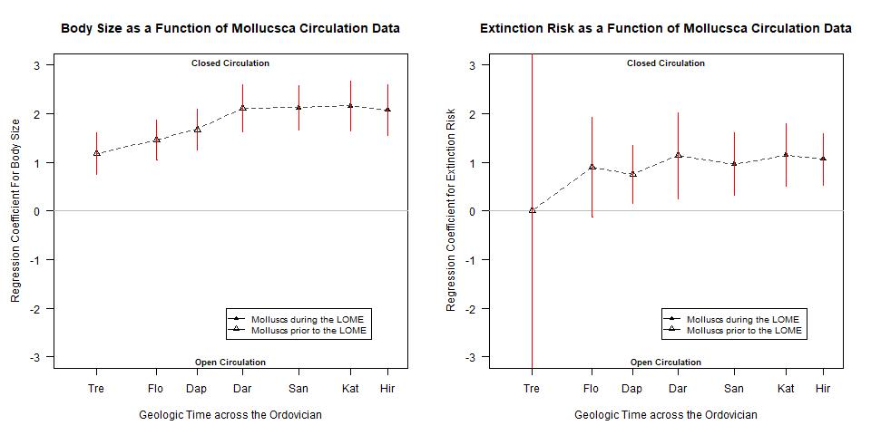
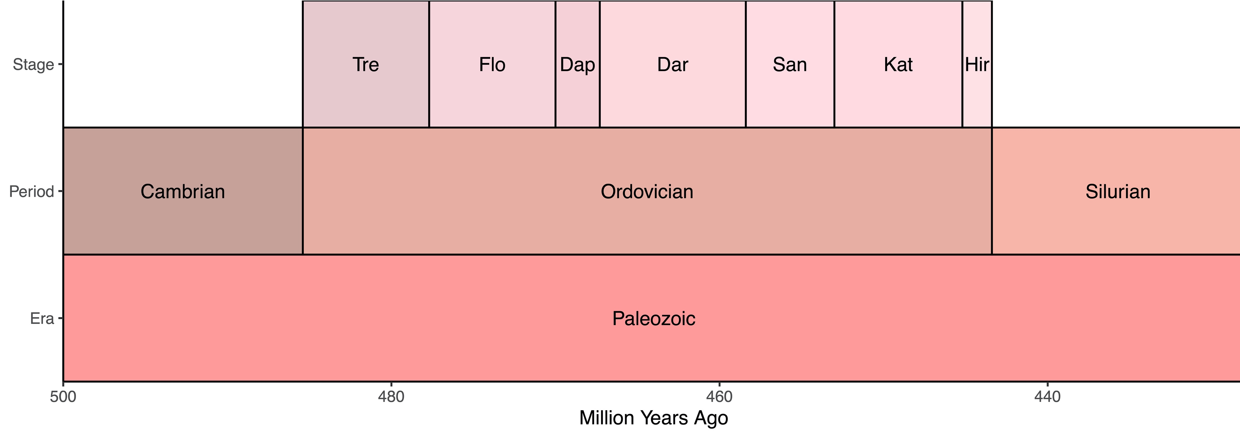
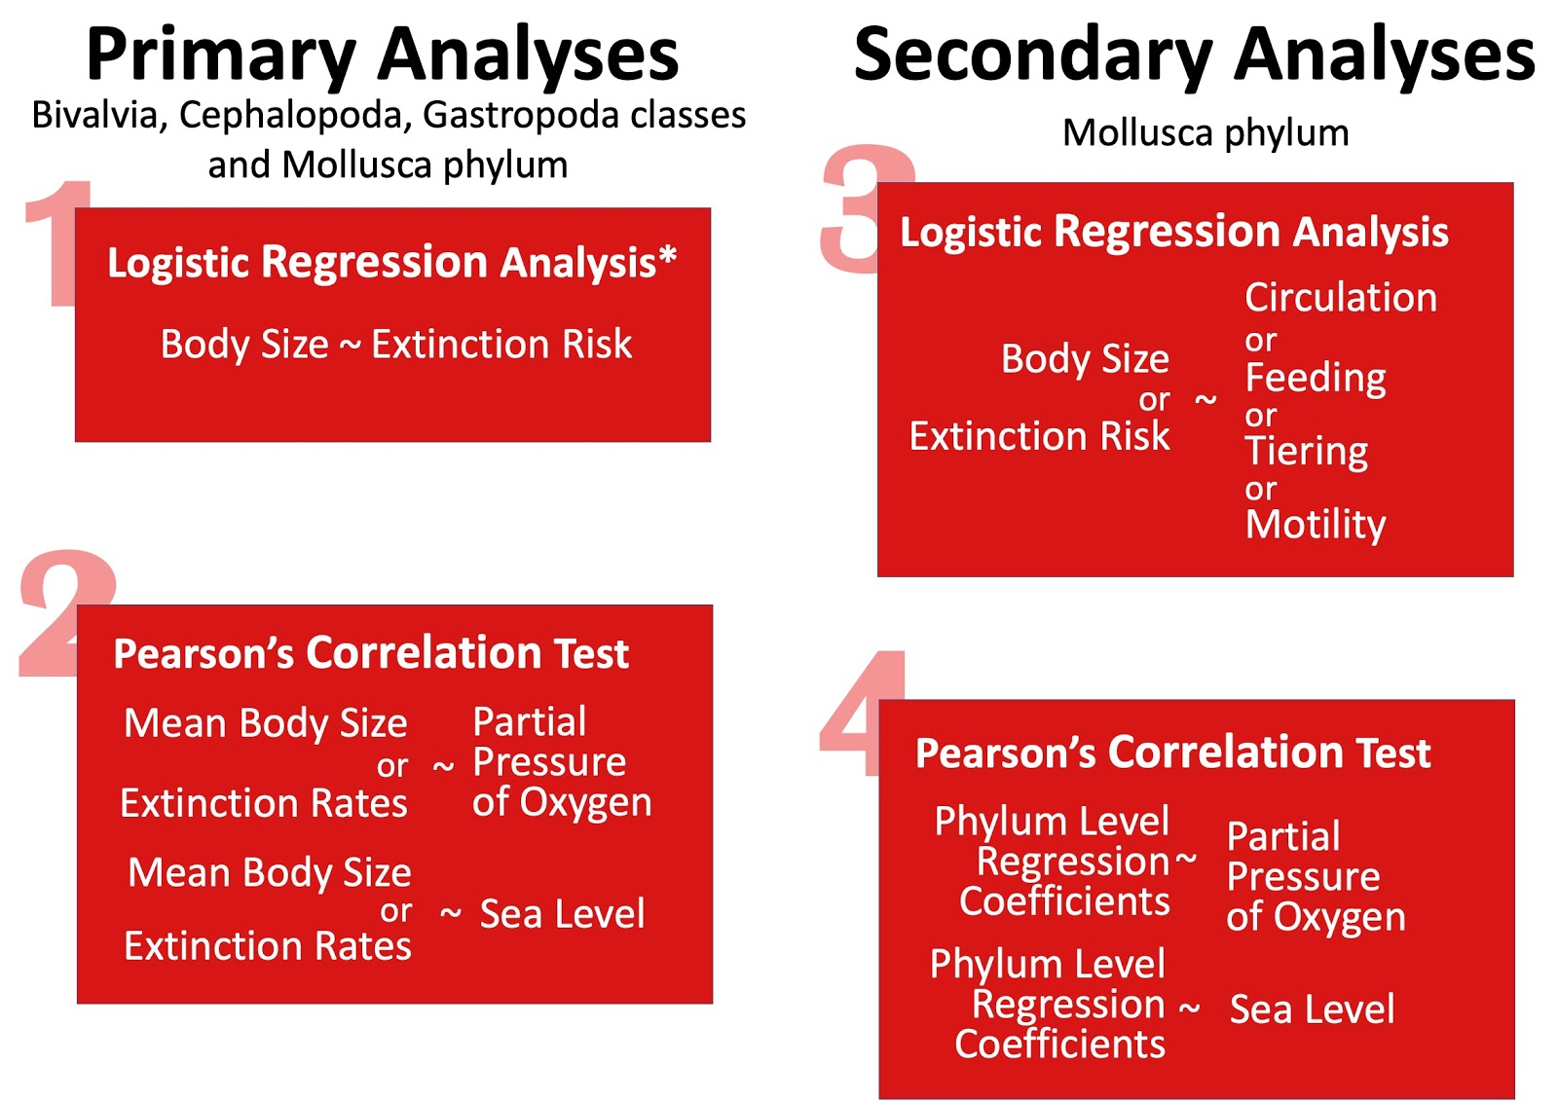
Identifying Driving Factors of Extinction and Body Size for Molluscs During the Late Ordovician Mass Extinction
Adarsh S. Ambati, Ilinca M. Flacau, Addy V. Ngo, Pedro M. Monarrez, Michael Pimentel-Galvan, Noel A. Heim, Jonathan L. Payne
Stanford Earth Young Investigators
Stanford Earth Young Investigators
Stanford Earth Young Investigators
Stanford University
Stanford University
Tufts University
Stanford University
Abstract
Figures
Results
While trends between extinction and body size have been explored extensively, few have studied them within the Late Ordovician Mass Extinction (LOME). None have attempted to observe it with Mollusca as a focal point. Additionally, our research investigated ecological factors and their relationship with body size and extinction risk.
Using R, we subsetted data from Heim et al. 2015 into three main classes, Cephalopoda, Bivalvia, and Gastropoda. First, we conducted logistic regression analyses to determine the odds of extinction based on calculated fossil biovolume. Next, we ran Pearson’s Correlation test to compare the calculated odds to the sea level and pO₂ of each Ordovician stage. Secondary logistic regression analyses were performed on the entire molluscan dataset, comparing body size and extinction to circulation, feeding, motility, and tiering data, followed by correlation tests between these odds and sea level and pO₂. While our first test for the main classes yielded no significant results, our second tests involving ecological traits found significant (p < 0.05) and strongly positive coefficients. For example, there were high odds of extinction for molluscs with closed circulation. The regression coefficient for extinction risk and genera with closed circulation was 1.06 in the LOME, indicating that such organisms were more likely to go extinct. Analysis revealed this likelihood had actually reduced from earlier stages. Additionally, there were strong positive correlations between coefficients for extinction and body size for the traits of predatory feeding, water column tiering, and a closed circulation. These are all features of cephalopods, indicating that the high coefficients are due to cephalopodic extinction. Furthermore, the correlations between the calculated coefficients of body size, extinction risks, and ecological factors to pO₂ and sea levels yielded mixed yet significant results.
While there exists no clear relationship between body size and extinction for molluscs in the LOME, alternative physiological and ecological information act as better predictions for body size and extinction risk during this time. These factors clearly play a role in the underpinning mechanisms of mass extinctions, indicating that extinction trends are more complex than simple correlations.
A
Primary Analysis:
No significant regression coefficients between Body Size and Extinction Rates for phylum Mollusca and the individual classes of Cephalopoda, Gastropoda, and Bivalvia
However, there is a shift in the relationship between body size and extinction rates during the Late Ordovician Mass Extinction
Bivalves, Cephalopods, and Gastropods had no significant result but it seemed that smaller organisms tended to have a high extinction risk during the LOME
For Molluscs, larger organisms tended to have a high extinction risk, during the LOME, although this tendency was decreasing
There is a negative, significant correlation between mean body size and pO₂ Levels (R=-0.853, p-value = 0.015), and after the Floian, there is a noticeable, positive correlation between extinction rates and pO₂ Levels (R = 0.808, p-value =0.051)
There is no significant correlation between Mean Body Size and Sea Levels (R=0.234, p-value=0.5825) or Extinction Rates and Sea Levels (R=-0.203,p-value=0.965)
Secondary Analysis:
Strong, positive coefficients indicated close circulatory, predatory, motile, and water-column molluscs tended to have a large body size yet a higher risk of extinction
Significant(>95%) and negative correlations existed between pO₂ and the regression coefficients of Circulation vs Extinction, Feeding vs. Body Size, and Tiering vs Extinction.
Near significant correlations existed positively between pO₂ and the regression coefficients of Circulation vs. Body Size, Feeding vs Extinction, Motility vs. Body Size, and Tiering vs. Body Size as well as negatively between sea level and Body Size vs. Extinction Coefficients
There exists a significant, positive correlation between Predatory Feeding, Benthic Tiering, Closed Circulation, traits of Cephalopods
B
C
D
Figure 1: Extinction Risk As a Function of Body Size Across Mollusca and Molluscan Classes
A
B
C
D
Figure 2.A
Figure 2.B
Figure 2: Mean Body Size and Extinction Rates in relation to Sea and pO₂ Level
Discussion
A
B
C
D
On the whole, our tests yielded results different from what was expected. Past research concerning body size trends during mass extinction events has suggested that larger organisms preferentially go extinct. However, our analyses revealed no significant correlation between body size and risk of extinction for molluscs during the Late Ordovician Mass Extinction, although smaller organisms tended to have a high extinction risk on a class level. However, there is a strong correlation between pO₂ levels and mean body size extinction rates for all molluscs, although as this result is a correlation between rates not odd, it cannot be used as a predictor for extinction and body size but remains a significant relationship. Additionally, other ecological and physiological factors provide even more insight into extinction and body size patterns. Throughout the entire Ordovician, there were strong positive correlations between extinction and body size and the ecological and physiological traits of tiering, circulation, motility, and feeding. More notably, there is a distinct difference in these correlation coefficients during the LOME. Over the course of the Great Ordovician Biodiversification Event (GOBE), these relations were increasing. Adversely, the correlation between the ecological or physiological factors and extinction and body size, either stagnated or decreased, although remaining strongly positive. Testing the relationship between tiering, circulation, and feeding data resulted in extremely strong, significant correlations, alluding to the presence of confounding factors. Many of these traits associated with preferential extinction -- predatory feeding, water column tiering, and a closed circulation -- belong to cephalopods, indicating that the strong correlation could be a result of cephalopodic extinction. However, motility remained disparate from the other three variables. Further research is necessary to determine which of these factors is the most impactful on the extinction rate of cephalopods. In the end, our results identified significant relationships between ecological traits, pO₂, extinction risk, and body size. Thus, while body size itself may not be a significant driving factor in extinction risk, circulation, motility, tiering, feeding traits, and oxygen levels act as better predictors for both body size and extinction risk of molluscs during the LOME.
~
Methodology
E
F
G
H
All analyses and plots were made using the programming language R
All the calculated biovolume data was checked and found normal
Calculated Biovolume was significantly correlated with fossil length and, thus, deemed suitable as a representative for size
*Logistic Regression Analyses were performed for each stage of the Ordovician _{(*See Timeline Below*)}
Body Size : Base 10 Logarithm of the Calculated Biovolume
Circulation: Open vs Closed
Feeding : Predatory vs Non-Predatory (Suspension, Surface Deposit, Mining, Grazing, and Other)
Tiering: Pelagic vs Sea Floor and Below (Erect, Surficial, Semi-infaunal, Shallow infaunal, and Deep infaunal)
Motility: Freely vs Sedentary _{(Facultative and Non-motile)}
Figure 3: Extinction Risk and Body Size as a Function of Ecological and Physiological Factors
 | pO₂ Correlation Coefficient | P-Value | Significant? | Sea Level Correlation Coefficient | P-Value | Significant?
Body Size vs. Extinction Risk | -0.087 | 0.854 | N | 0.730 | 0.063 | N (Barely)
Circulation vs. Body Size | -0.685 | 0.089 | N (Barely) | 0.581 | 0.172 | N
Circulation vs Extinction Risk | -0.814 | 0.026 | Y | 0.412 | 0.358 | N
Feeding vs. Body Size | -0.778 | 0.040 | Y | 0.544 | 0.207 | N
Feeding vs Extinction Risk | -0.747 | 0.054 | N (Barely) | 0.210 | 0.652 | N
Motility vs. Body Size | -0.734 | 0.060 | N (Barely) | 0.150 | 0.750 | N
Motility vs Extinction Risk | -0.280 | 0.542 | N | -0.134 | 0.775 | N
Tiering vs. Body Size | -0.746 | 0.054 | N (Barely) | 0.579 | 0.174 | N
Tiering vs Extinction Risk | -0.825 | 0.022 | Y | 0.410 | 0.362 | N
Acknowledgements
Thank you Dr. Monarrez for his guidance and instruction throughout the entirety of the internship to bring our project to fruition. As well as a thank you to Michael for his assistance with R. Thank you to Dr. Saltzman for making this invaluable experience possible virtually despite the pandemic. Also, a thank you to Dr. Jonathan Payne and Dr. Noel Heim for the studies as well as being available for any questions about the research.
Table 1: pO₂ and Sea Level Correlation Coefficients with Secondary Analyses Regression Coefficients
 | Tiering- ER | P-Value | Feeding- ER | P-Value | Mot.- ER | P-Value | Circ. - ER | P-Value
Tiering - ER | N/A | N/A | 0.903 | 5.35E-03 | 0.463 | 2.96E-01 | 0.921 | 3.26E-03
Feeding - ER | 0.903 | 5.35E-03 | N/A | N/A | 0.714 | 7.18E-02 | 0.796 | 3.22E-02
Motility ER | 0.463 | 2.96E-01 | 0.714 | 7.18E-02 | N/A | N/A | 0.280 | 5.44E-01
Circulation - ER | 0.921 | 3.26E-03 | 0.796 | 3.22E-02 | 0.280 | 5.44E-01 | N/A | N/A
 | Tiering- BS | P-Value | Feeding- BS | P-Value | Mot.- BS | P-Value | Circ - BS | P-Value
Tiering- Body Size | N/A | N/A | 0.997 | 1.27E-06 | 0.297 | 5.18E-01 | 0.990 | 2.04E-05
Feeding- Body Size | 0.997 | 1.27E-06 | N/A | N/A | 0.332 | 4.68E-01 | 0.984 | 6.20E-05
Motility- Body Size | 0.297 | 5.18E-01 | 0.332 | 4.68E-01 | N/A | N/A | 0.172 | 7.12E-01
Circulation- Body Size | 0.990 | 2.04E-05 | 0.984 | 6.20E-05 | 0.172 | 7.12E-01 | N/A | N/A
Citations
N. A. Heim, Knope M. L., Schaal. E. K., Wang S. C., Payne, J. L. 2015. Cope’s rule in
the evolution of marine animals. Science 347, 867-870. Berner, R. A. 2009. Phanerozoic atmospheric oxygen: New results using the
GEOCARBSULF model. American Journal of Science 309, 603-606. Rasmussen, C. M. Ø., Kröger, B., Nielsen, M.L., Colmenar, J. 2019. Cascading trend of Early Paleozoic marine radiations paused by Late Ordovician extinctions. Proceedings of the National Academy of Sciences 116, 7207-7213.
Knope, M. L., Heim, N. A., Frishkoff, L. O., and Payne, J.L. 2015. Limited role of
functional differentiation in early diversification of animals. Nature
Communications 6, 6455. Bush, A.M., Bambach, R.K., and Daley, G. 2007.Changes in theoretical ecospace utilization in marine fossil assemblages between the mid‐Paleozoic and late Cenozoic. Paleobiology 33, 76–97.
Heim, N. A., Bakshi, S., Buu, L., Chen, S., Heh, S., Jain, A., Noll, C., Patkar, A., Rizk, N., Sundararajan, S., Villante, I., Knope, M. L., Payne, J. L. 2020. Respiratory medium and circulatory anatomy constrain size evolution in marine macrofauna. Paleobiology, 1-16. doi:10.1017/pab.2020.16
Kosnik, M. A., Jablonski, D., Lockwood, R., & Novack-Gottshall, P. M. (2006). Quantifying Molluscan Body Size In Evolutionary And Ecological Analyses: Maximizing The Return On Data-Collection Efforts. Palaios, 21(6), 588-597. doi:10.2110/palo.2006.p06-012r
Novack-Gottshall, P. M. (2008). Ecosystem-wide body-size trends in Cambrian–Devonian marine invertebrate lineages. Paleobiology, 34(2), 210-228. doi:10.1666/0094-8373(2008)034[0210:ebticm]2.0.co;2 Payne, J. L. (2005). Evolutionary dynamics of gastropod size across the end-Permian extinction and through the Triassic recovery interval. Paleobiology, 31(2), 269-290. doi:10.1666/0094-8373(2005)031[0269:edogsa]2.0.co;2
Table 2: Correlation Test Between Extinction Risk(ER) Coefficients
Table 3: Correlation Test Between Body Size(BS) Coefficients

